Slide 1
T1S Autoconfiguration Tooling
13. Februar 2024
Martin Ruppert

Slide 2
Motivation
To give us ESE a learning curve in
T1S Technology
C and Pyhton Coding
Project Working
git and Github
MDB Core
Soft- and Hardware Testing
This project is not about creating a Software Engineering Company within the Microchip Sales Organization. It is about to learn the processes, structures and vocabulary that our customer are dealing with
All items in the list above could be used in total different customer support processes
And maybe another result could be a proof of concept for customers in the industrial area for an T1S autoconfiguration scenario

Slide 3
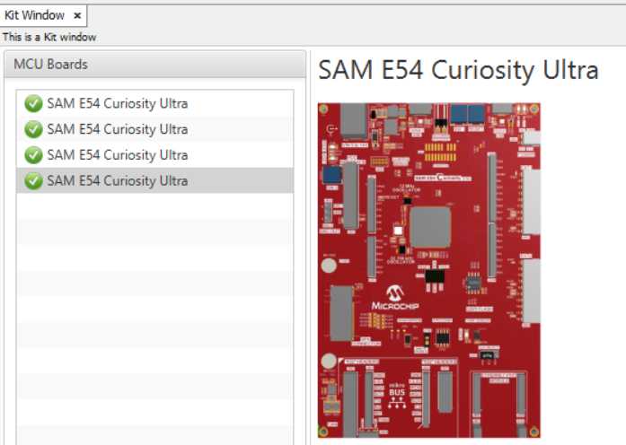
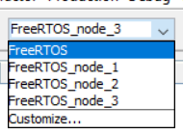
Motivation
When you have four T1S Nodes, you need 4 Evalkits and 4 different HEX files.
With conditional compiling you can have one project with four configuration.
But better would be one firmware for all
But allways compile four times a project and programming afterwards four board
Can be confusing and time consuming. How can this be done easier?

Slide 4
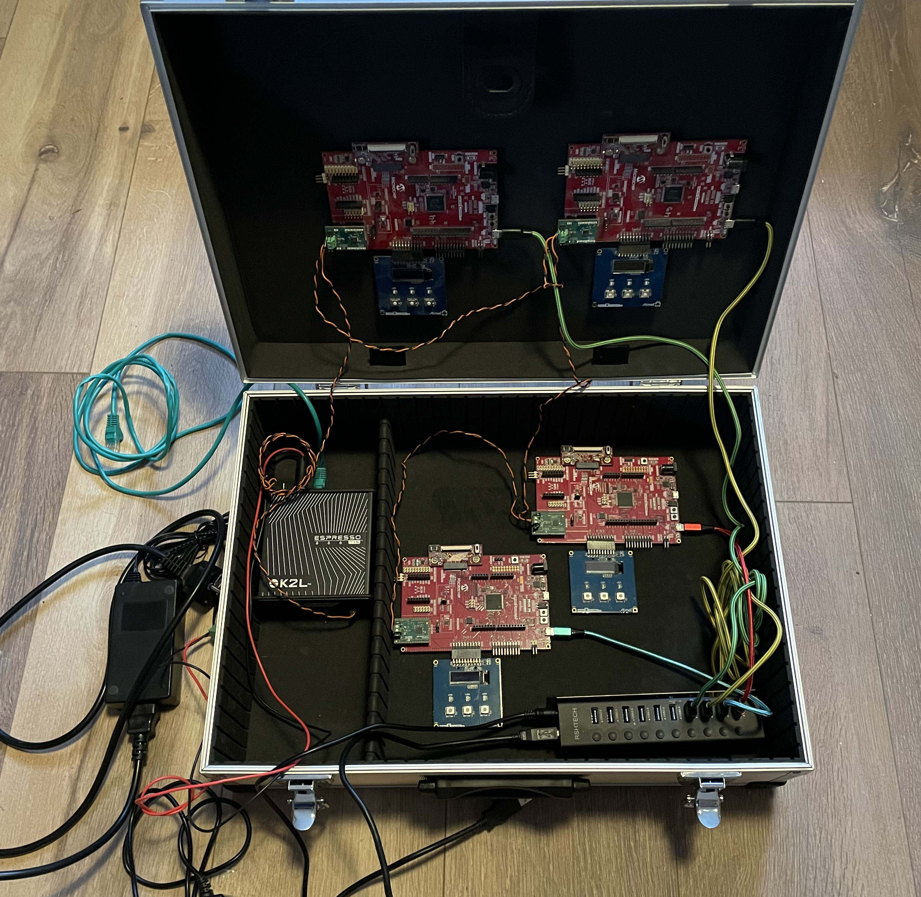
GOAL
One Firmeware for all boards
Communication between boards should be visible in the OLED1 Extension
Demo should be controlable with only the OLED1 Extension
More complex operations can be done via a terminal
Hardware
SAME54 Curiosity
T1S PHY Daughter Board
OLED1 Xplained Extension

Slide 5
Github Project
The whole project inclusive all Pyhton Codes and the Presentation is hosted on github at
https://github.com/Bolderain/T1S_Autoconf
It is a Fork of
https://github.com/Microchip-MPLAB-Harmony/net_10base_t1s.git
from version v1.3.0
The target is to make it official available at https://github.com/MicrochipTech
The current Branch is called „one_firmware“ (as of January 2024)

Slide 6
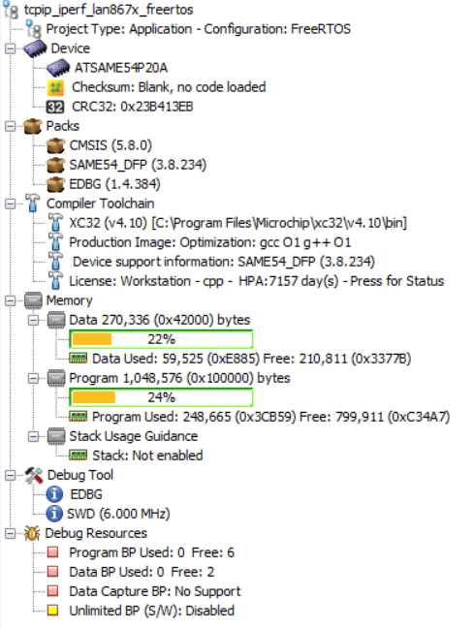
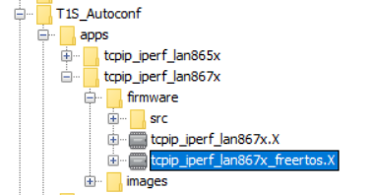
MPLABX Project
git clone https://github.com/Bolderain/T1S_Autoconf.git
git checkout one_firmware

Slide 7
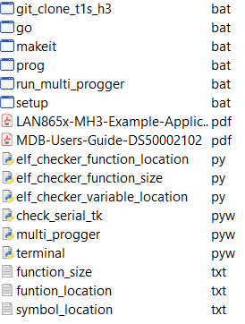
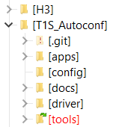
Cloning the Framework with «one click»
The script git_clone_t1s_h3.bat clones all neccessary Harmony repositories in the directory H3 (one directory level higher)
You can adjust the Framework Installation path in the In the script with
set H3_INSTALL="../../H3"
For beeing able to generate and and modify the T1S applications of version v1.3.0 with the MCC.
Call it from /tools

Slide 8
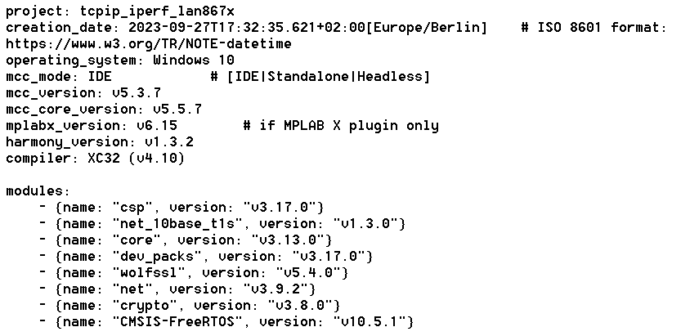
Cloning the Framework with «one click»
This git_clone_t1s_h3.bat clones several Harmony Repositories and checkout the needed versions. The neccessary Repositories and versions are derived from the projecta Manifest File „harmony-manifest-success.yml“
@ECHO OFF
set H3_GITHUB="https://github.com/Microchip-MPLAB-Harmony"
set H3_INSTALL="../../H3"
git clone -b "v10.5.1" https://github.com/ARM-software/CMSIS-FreeRTOS.git %H3_INSTALL%/CMSIS-FreeRTOS
git clone -b "v3.17.0" %H3_GITHUB%/csp.git %H3_INSTALL%/csp
git clone -b "v3.13.0" %H3_GITHUB%/core.git %H3_INSTALL%/core
git clone -b "v3.17.0" %H3_GITHUB%/dev_packs.git %H3_INSTALL%/dev_packs
git clone -b "v5.4.0" %H3_GITHUB%/wolfssl.git %H3_INSTALL%/wolfssl
git clone -b "v3.9.2" %H3_GITHUB%/net.git %H3_INSTALL%/net
git clone -b "v3.8.0" %H3_GITHUB%/crypto.git %H3_INSTALL%/crypto
git clone -b "v1.1.0" %H3_GITHUB%/devices.git %H3_INSTALL%/Devices
git clone -b "v1.3.0" %H3_GITHUB%/net_10base_t1s.git %H3_INSTALL%/net_10base_t1s
git clone %H3_GITHUB%/devices.git %H3_INSTALL%/devices
pause
@ECHO ON

Slide 9
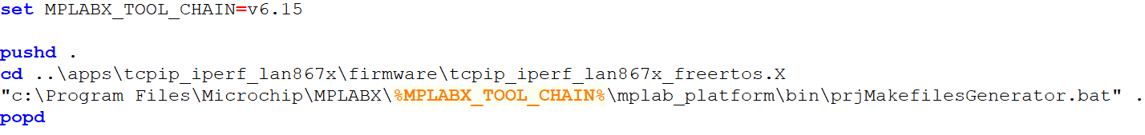
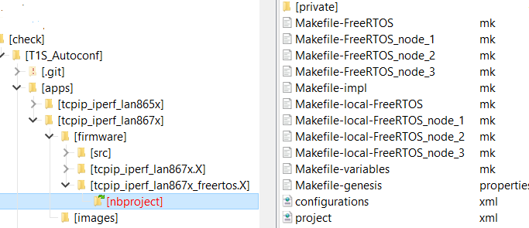
Generate Makefiles
The script setup.bat calls the „prjMakefilesGenerator.bat“
i.e. It creates all Makefiles. This is normally done by MPLABX when the project is opened. And allows to build the projects without using MPLABX
If another MPLABX Version should be used than v6.15, this must be changed in the script

Slide 10
Programming 4 Boards at the same time
If another MPLABX Version should be used than v6.15, this must be changed in the script
The Tool „multi_progger.pyw“ is a Python Tkinter GUI that controlls 4 instances of the MDB Core simultary.
This allows to keep the connection to four MDB‘s instances and programming four controller at the same time.

Slide 11
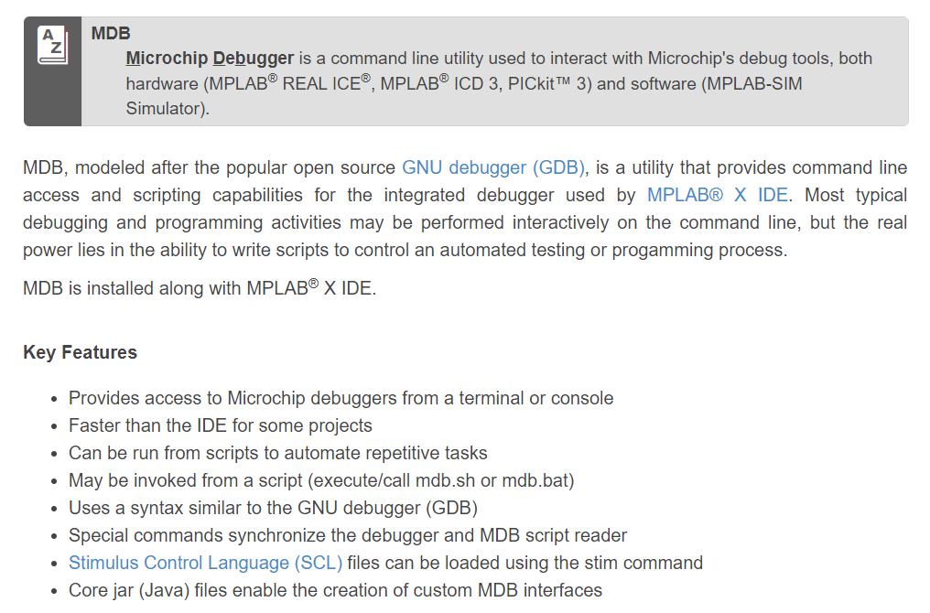
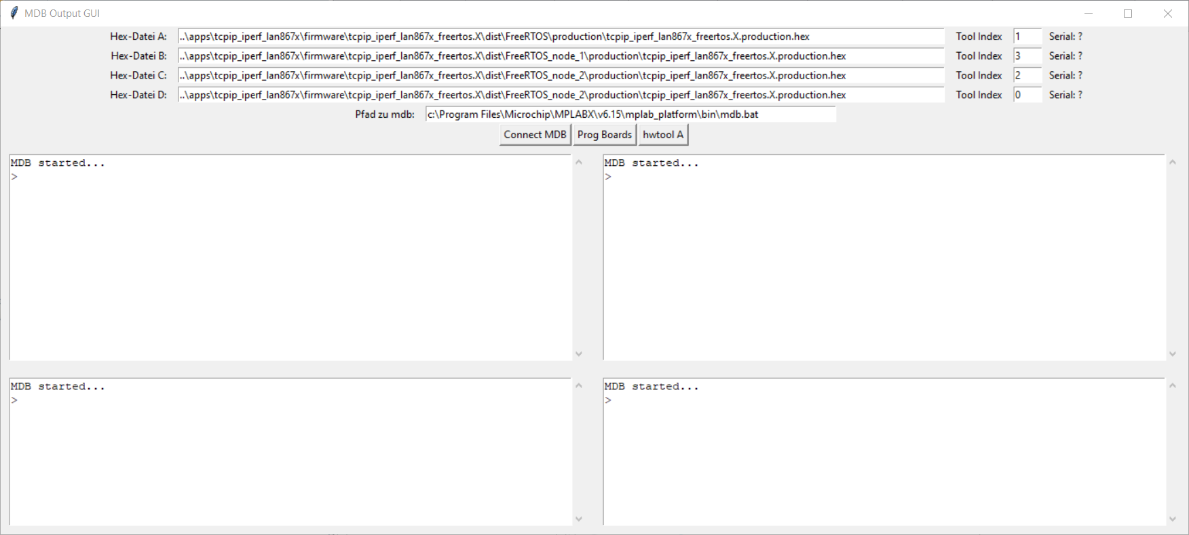
Python GUI for parallel Programming with MDB
The Pyhton Script starts MDB.bat as a Sub-Process and controlls the input and output. This allows a „remote control“ of the MDB.bat
More Information about the MDB and how to use it at: https://microchipdeveloper.com/mplabx:mdb

Slide 12
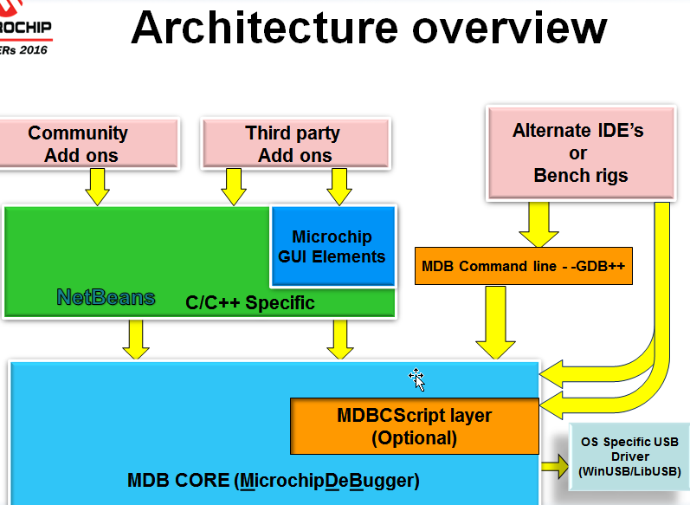
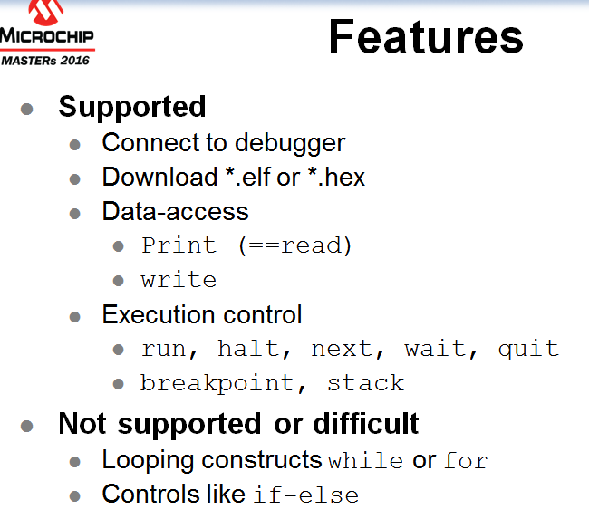
MDBCore / background
mdb.bat
MPLAX IDE
mdb.bat
mdbcs
Pre- & postprocess data/memory

Slide 13
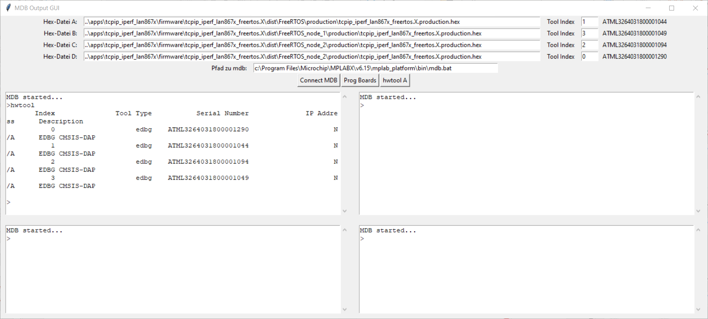
Python GUI for parallel Programming with MDB
„hwtool“ is a MDB command that lists all available debuggers and assigns them an index number. This index number is used to select the debugger
By changing the index number, a debugger can be specifically assigned to a window

Slide 14
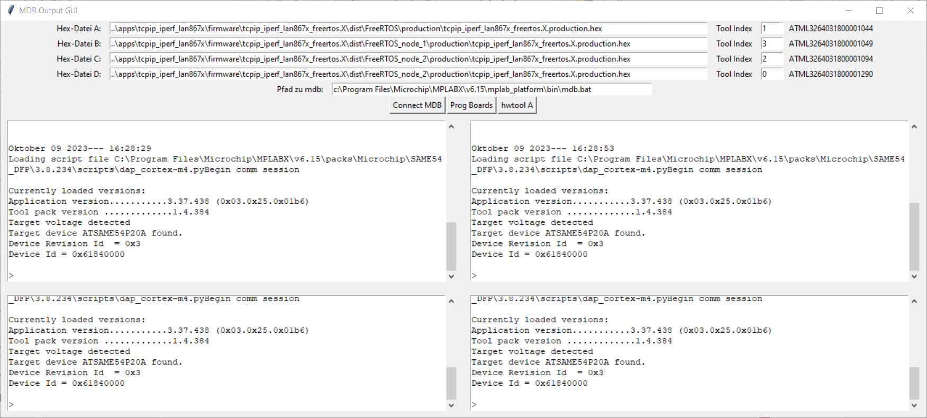
Python GUI for parallel Programming with MDB
With clicking on „Connect MDB“, all setup is done for EDGB, Speed 6Mbit, SWD Interface and selecting the debuggers. This takes some time until it‘s connected
Keep in mind that every mdb.bat process do need about 2 Gbyte of RAM. All four instancess are around 8 Gbyte of RAM

Slide 15
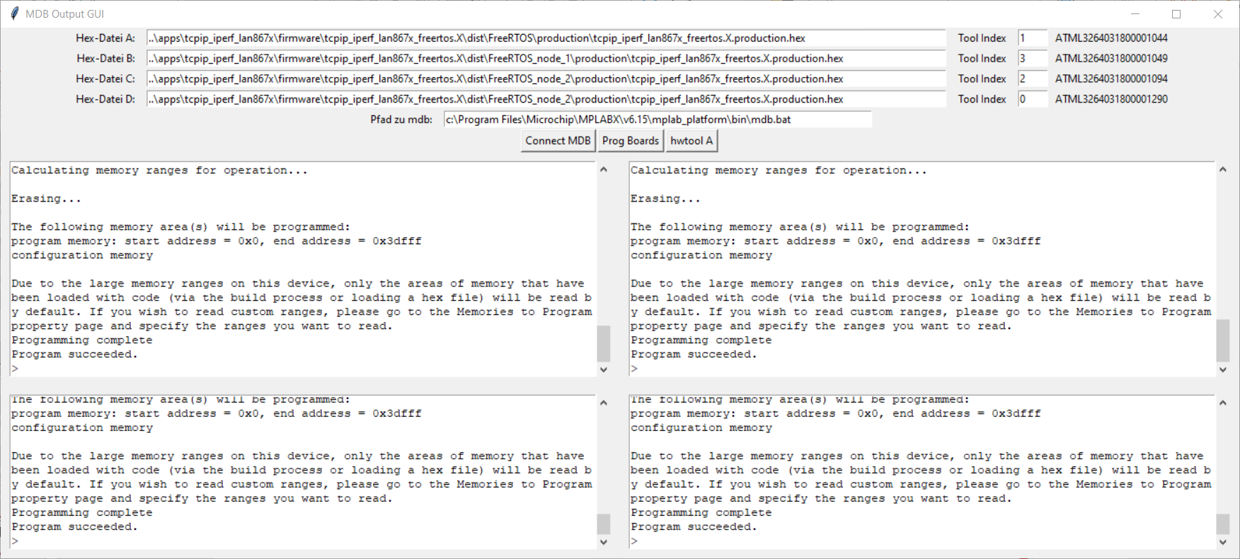
Python GUI for parallel Programming with MDB
“Prog Boards” programs all Hex files in parallel. The connection to the debugger is maintained so it is not necessary to re-establish the connection again. This allows the programming process to start more quickly.

Slide 16
Python GUI for testing 4 Boards in parallel
„terminal.pyw“ is the Terminal program that talks with 4 Boards at the same time.
The idea came to me when I was once again completely annoyed by having to arrange TerraTerm four times on my desktop and assigning them to the corresponding COM ports

Slide 17
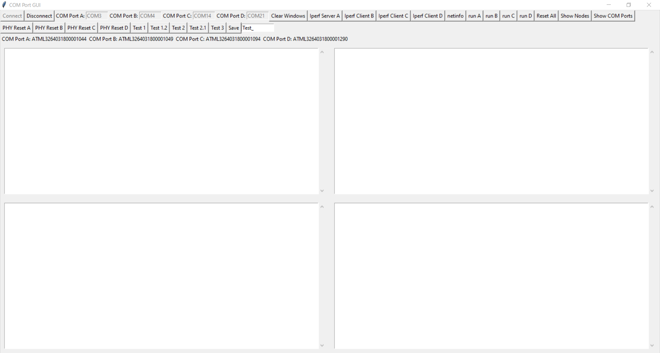
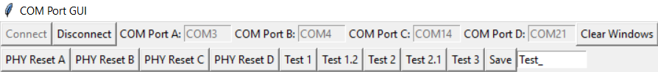
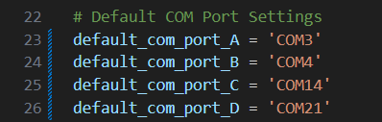
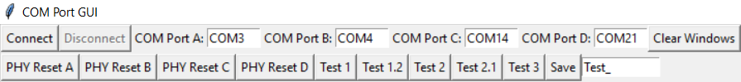
Python GUI for testing 4 Boards in parallel
If a COM Port entry is left free, this COM port is not used, so that this tool can be used with less than 4 boards
This tool is basically a 4-way Comport Terminal.
There are 4 default COM ports in the upper left, which must be changed to the ones on your machine.
If a COM Port entry is left free, this COM port is not used, so that this tool can be used with less than 4 boards
The default ports can be set in the source code
If you click on “Connect” while all comports are available, then the COM Port Entries go to gray.
If at least one COM Port isn’t available, nothing happens.

Slide 18

Python Modules Dependencies „terminal.pyw“
pip install pyserial
https://pythonhosted.org/pyserial/index.html
This module encapsulates the access for the serial port. It provides backends for Python running on Windows, OSX, Linux, BSD (possibly any POSIX compliant system) and IronPython. The module named “serial” automatically selects the appropriate backend.

Slide 19

Python Modules Dependencies „terminal.pyw“
pip install matplotlib
https://matplotlib.org/
Matplotlib is a comprehensive library for creating static, animated, and interactive visualizations in Python. Matplotlib makes easy things easy and hard things possible.

Slide 20
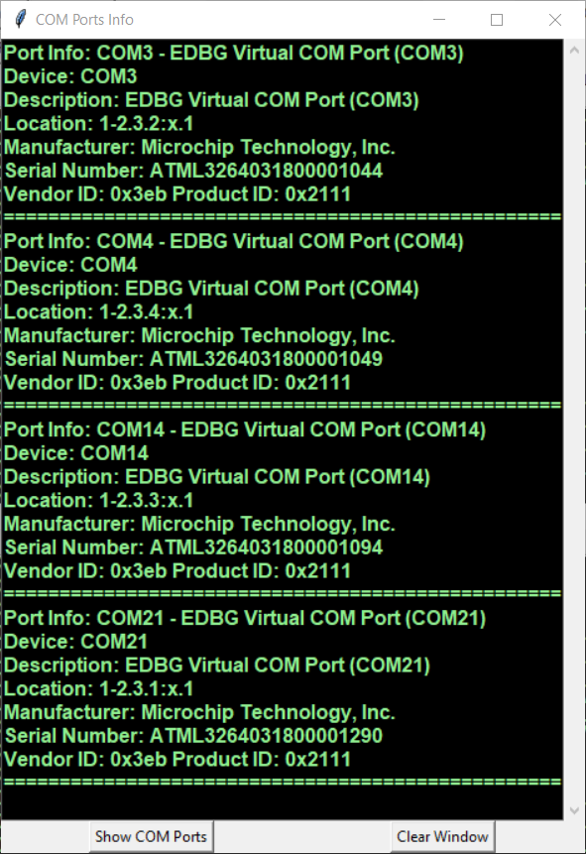
Python GUI for testing 4 Boards in parallel
A
B
C
D

Slide 21
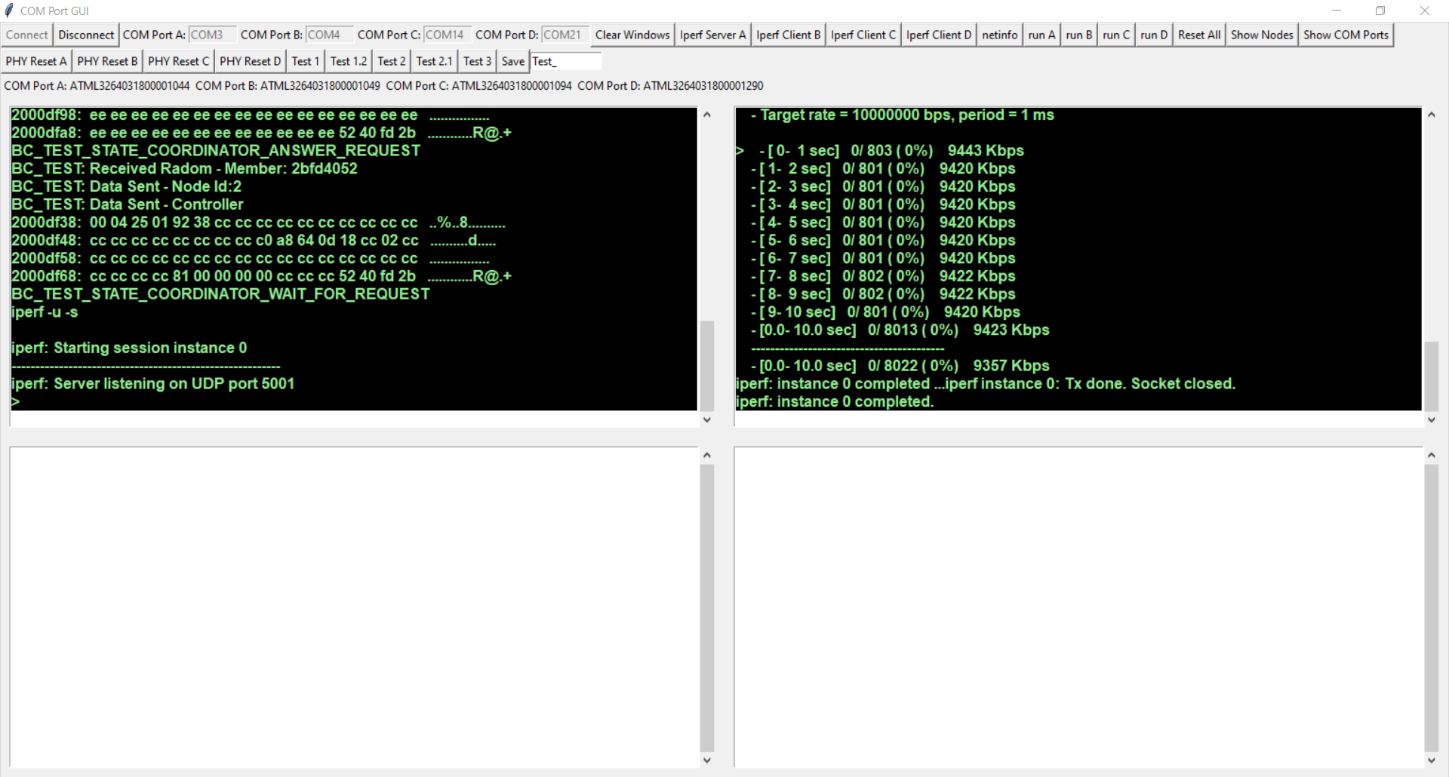
iperf with two boards
A Bandwidth of approx. 9.4 Mbit/sec UDP traffic is achieved between two boards

Slide 22
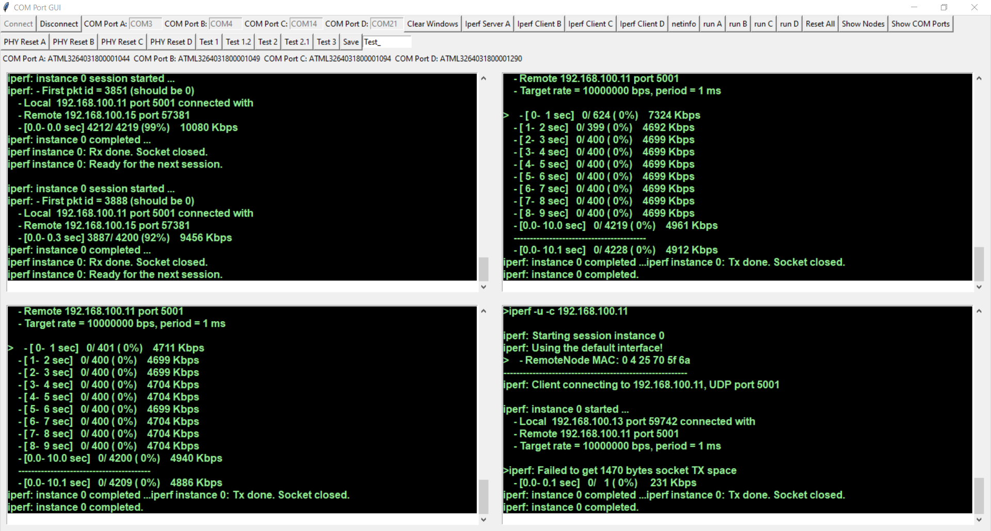
3 iperf client’s at the same time
A Bandwidth of approx. 3.1 Mbits/sec UDP Traffic is achieved when 3 iperf clients are running simultaneously

Slide 23
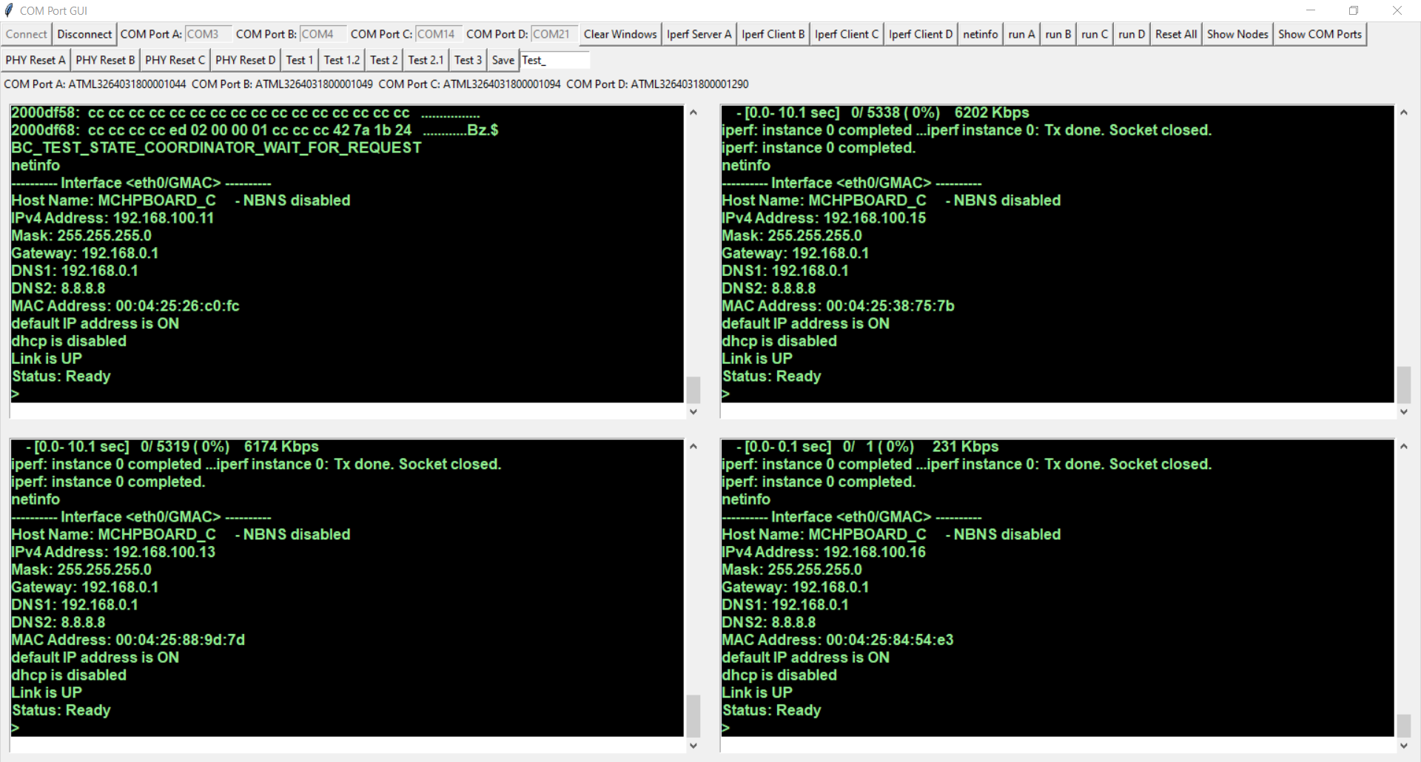
Sending the command “netinfo” to all boards
Pre defined commands can be send to one or more boards at the same time when a button is clicked.

Slide 24
Testing UDP commucation between boards
When it comes to test communication protocols, the 4 terminals make it much more convenient to debug the firmware by locking into the output of the boards
This firmware starts with the command “run”, the sending of an UDP Broadcast packet. If until 5 secs there was no answer, the firmware decides to be the “COORDINATOR” which answers to such packets. Inside this UDP packets, a timestamp is also exchanged so that all Boards LED’s can blink synchronously every 2 secs

Slide 25
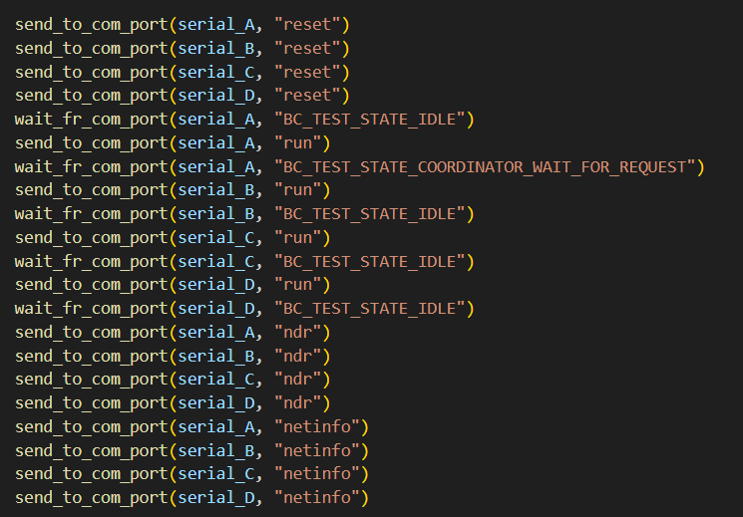
Test 1: Configure Boards Successive

Slide 26
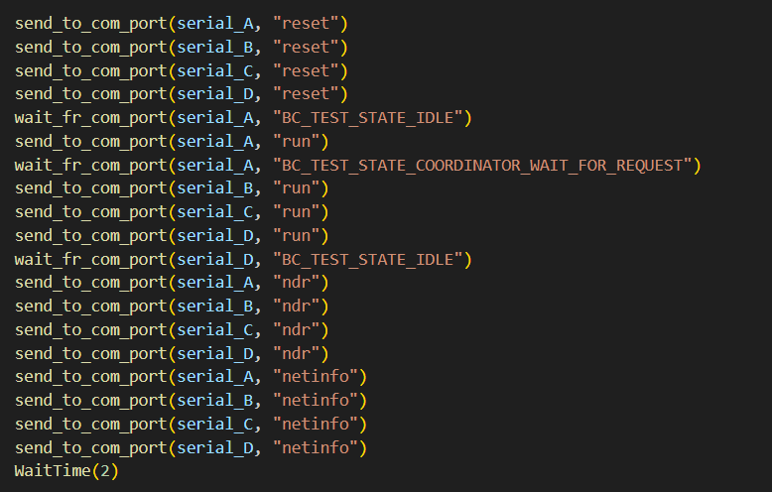
Test 1.2: Configure Boards Simultan

Slide 27
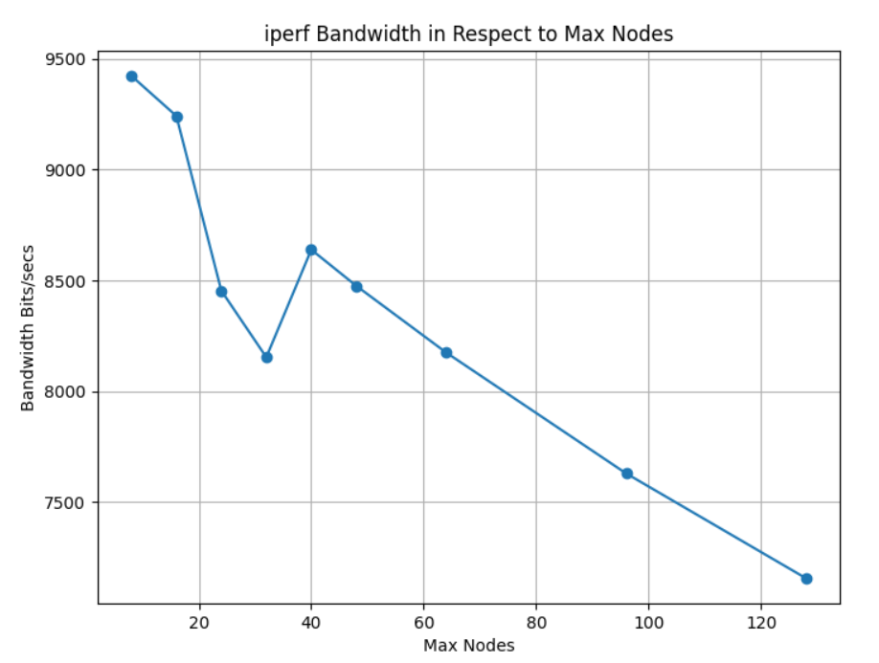
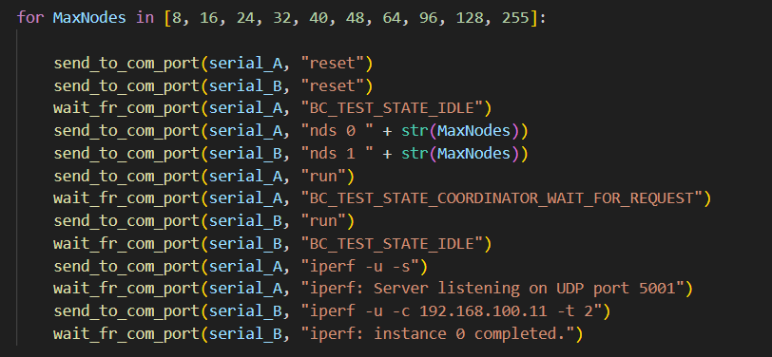
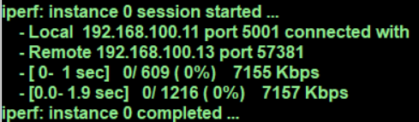
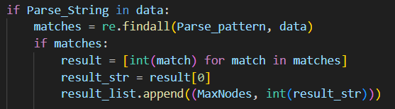
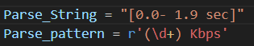
Test 2: iperf between two boards and varying the Max Nodes value

Slide 28
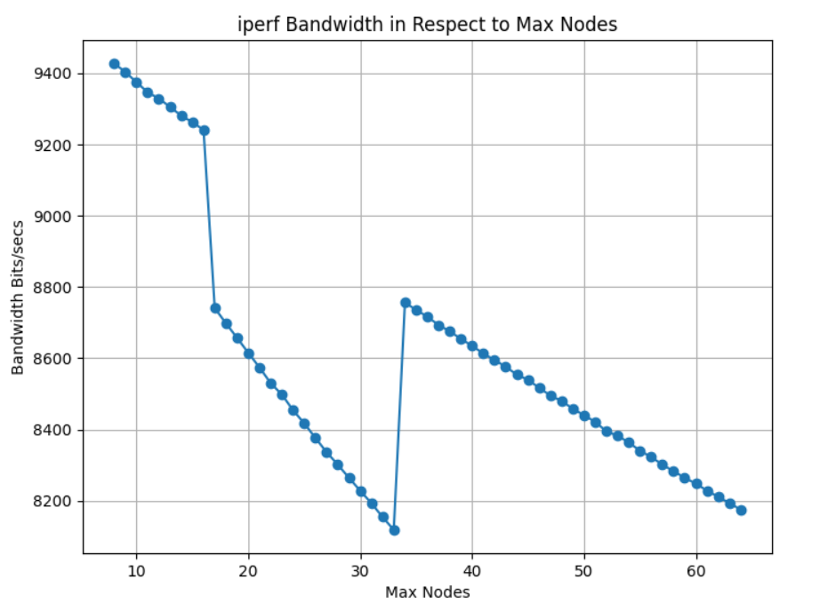
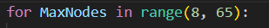
Test 2: iperf between two boards and varying the Max Nodes value

Slide 29
Software

Slide 30
OLED1 Display Support
printf for OLED Display

Slide 31
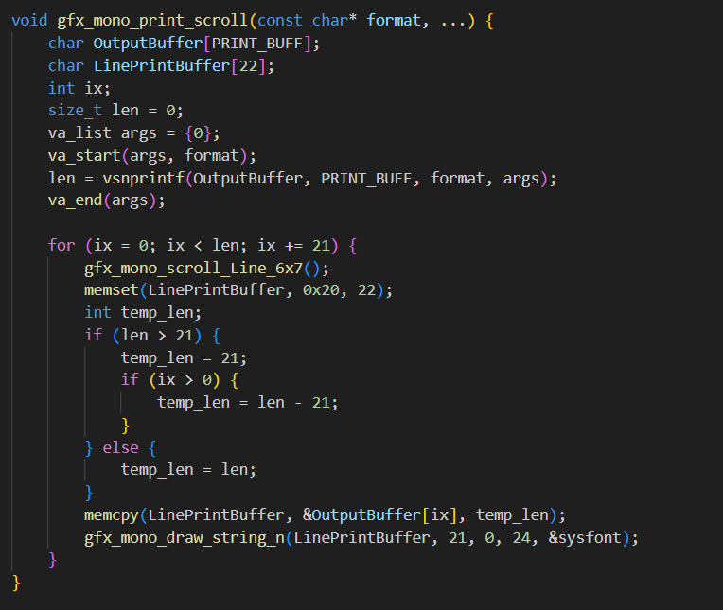
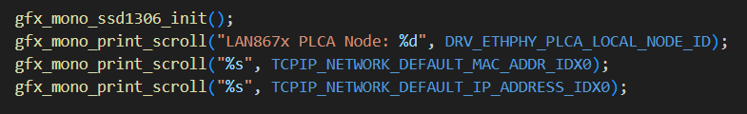

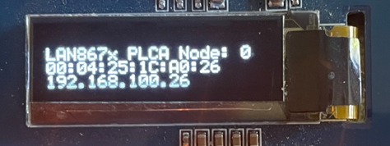
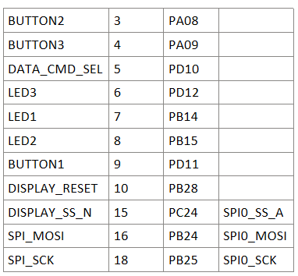
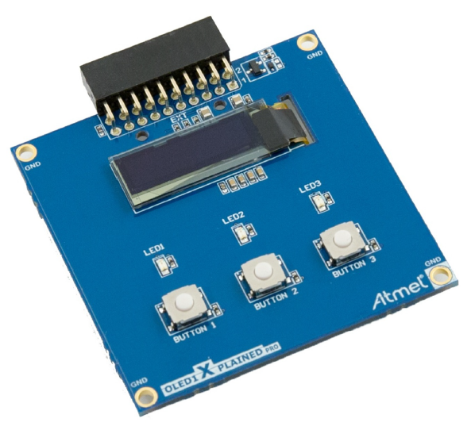

Slide 32
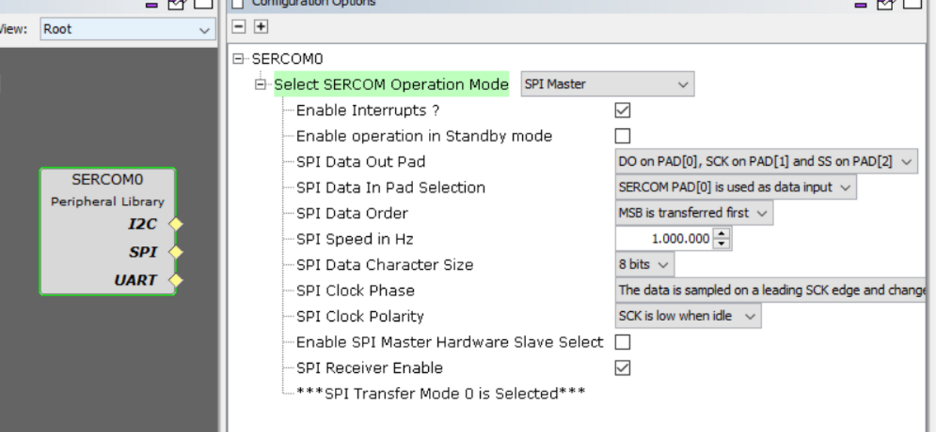
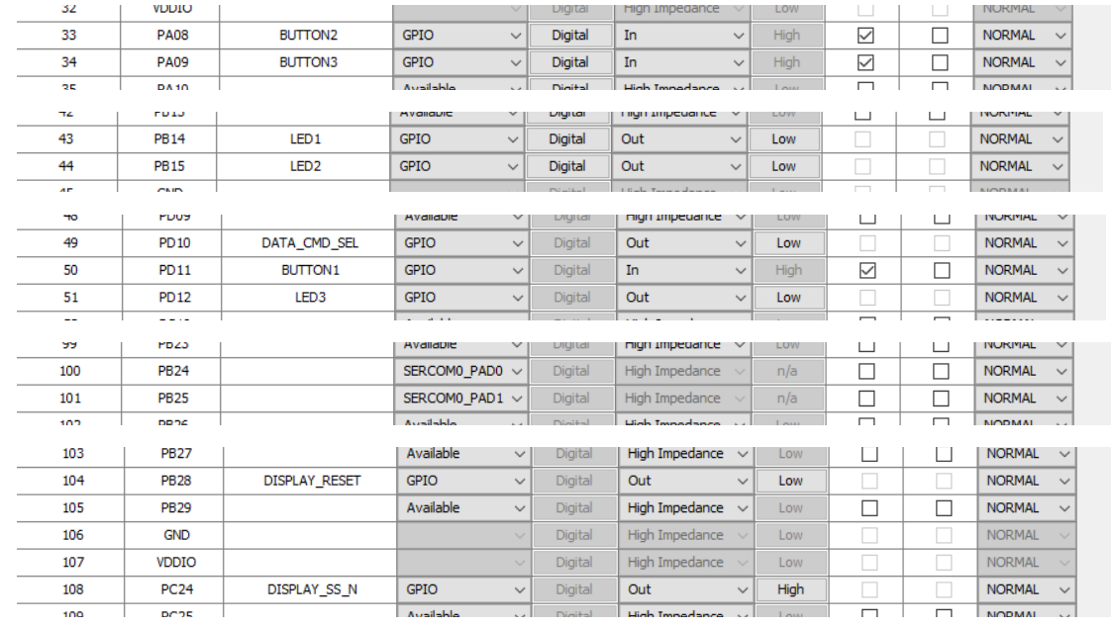
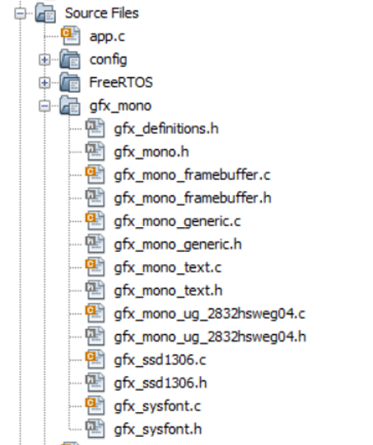
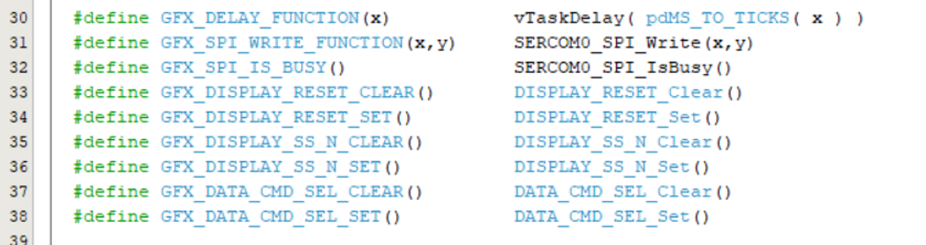
gfx_mono

Slide 33
Exception Handler
How to access the Stack Pointer in C

Slide 34
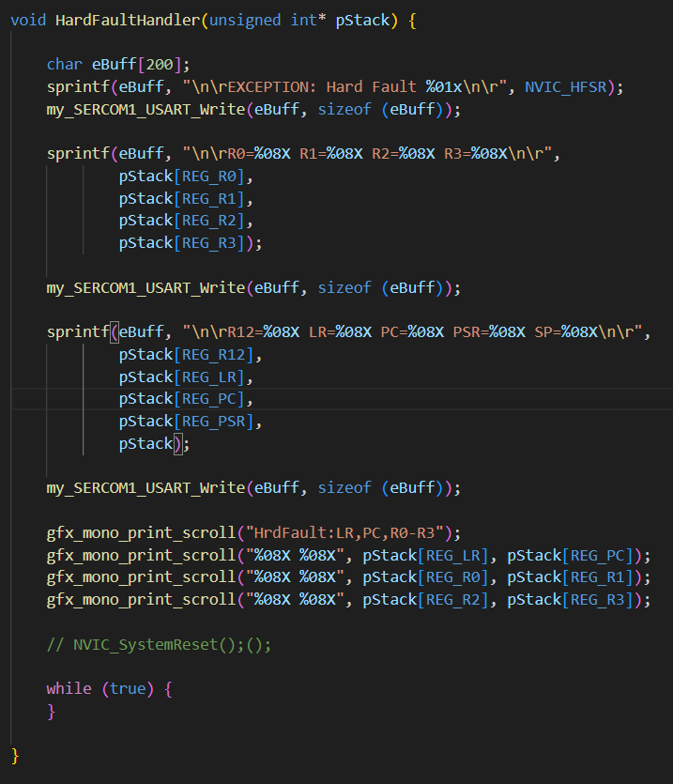
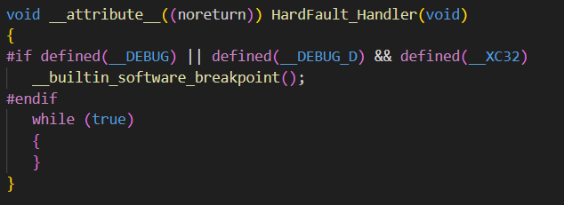
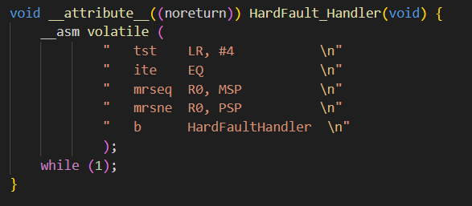
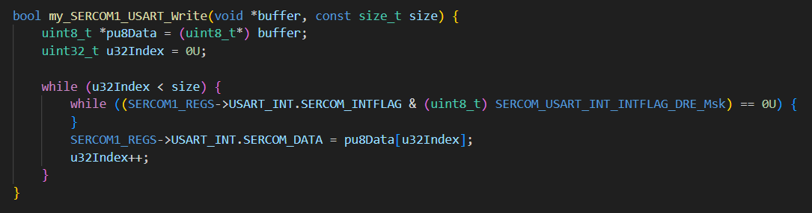
In case of an Exception this register are put onto the stack automatically:
R0-R3
R12
LR (Link Register)
PC (Program Counter)
PSR (Program Status Register)

Slide 35
R0-R3 (Registers 0 to 3):
General registers used to store data and intermediate results.
R12 (Register 12):
Also a general register used to store data and intermediate results.
LR (Link Register):
The link register stores the return address of the current program so that normal program flow can be restored after the execution of a subprogram or an exception.
PC (Program Counter):
The program counter is a register that contains the address of the next instruction to be executed in the program code. When an exception occurs, the PC is set to the address of the exception handler.
PSR (Program Status Register):
The Program Status Register contains status information about the status of the processor. This includes flags for the status bits (such as Z, N, C, V), the execution mode (thread or handler mode), the state of the interrupt (enabled or disabled), and other status information.

Slide 36
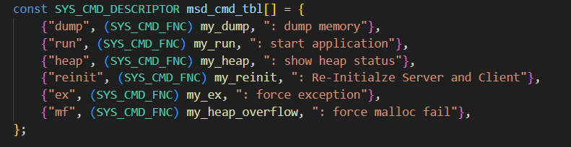
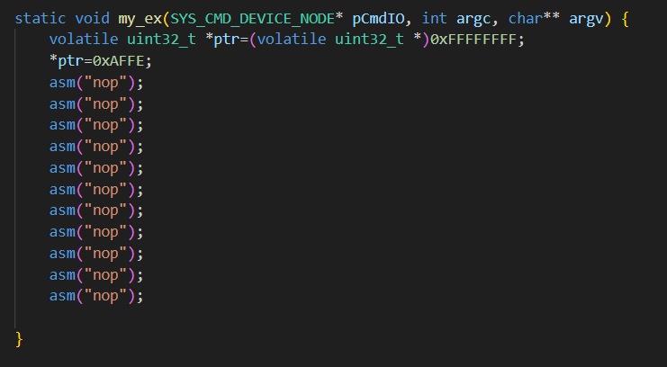
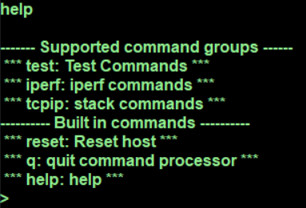


Adding a „Bus Fault Exception Test“ command

Slide 37



readelf –s x.elf
Creates Disassembly Listing File
objdump –S x.elf
Create Symbol List

Slide 38
Firmware State Machine
And how you can observe that

Slide 39


Node 0 sends a cyclic Beacon Frame (PLCA Mode)
In this case it is preconfigured for 8 Nodes. After the Beacon there are 8 Transmit Opportunities (Timeslots)
0
1
2
3
4
5
6
7
27,07us
29,2us
2,128us

Slide 40



Soft-Watchdog-Timeout

Slide 41


Slide 42
Dump Memory
Like in the good all times

Slide 43





Slide 44
Heap Managment
How do you find the culprit of a malloc fail?

Slide 45







Slide 46
Heap Managment
Show Heap Statistics

Slide 47





Slide 48
Virtual Command Receive
How send Commands by the Firmware

Slide 49





Slide 50
Position Detection
Where Am I?

Slide 51

T1S Network

Slide 52



OPEN Alliance 10BASE-T1S Topology Discovery

Slide 54
Obsolete Slides

Slide 55


Conditional Compilation through Predefined Symbols
This allows to have one project for 4 different boards.
Every board do need a different MAC, IP, NodeID

Slide 56

Build all configurations
If another MPLABX Version should be used than v6.15, this must be changed in the script
The script „makeit.bat“ call the make utility to build all configuration on the command line

